Slide 1
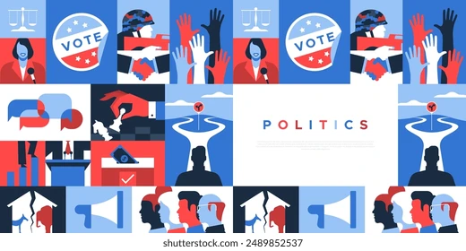
Welcome to the world of politics where the justice and laws are balanced together!

Slide 2
Starting off, what actually the politics is?
At its heart, politics is about power and decision-making in society.
It usually answers for these questions given:
Who gets to decide?
What gets decided?
In whose interest?
And finally, By what means (votes, pressure, money, influence, force)?
Politics exists any time people live together — in countries, cities, schools, companies, even families. Whenever resources, rules, or values are involved, politics appears…

Slide 3
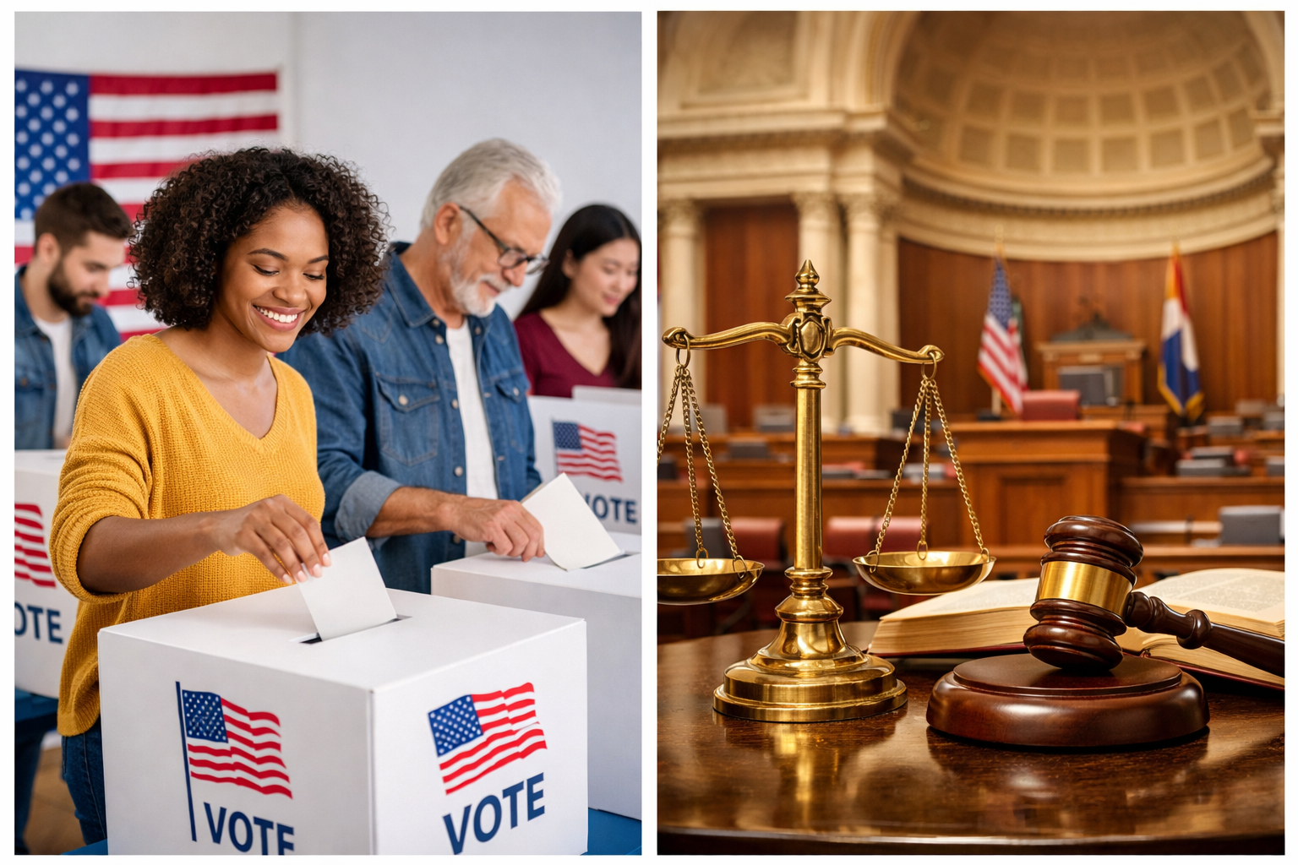

Here are two main branches of politics that we will discuss today:
Democracy
Meritocracy

Slide 4
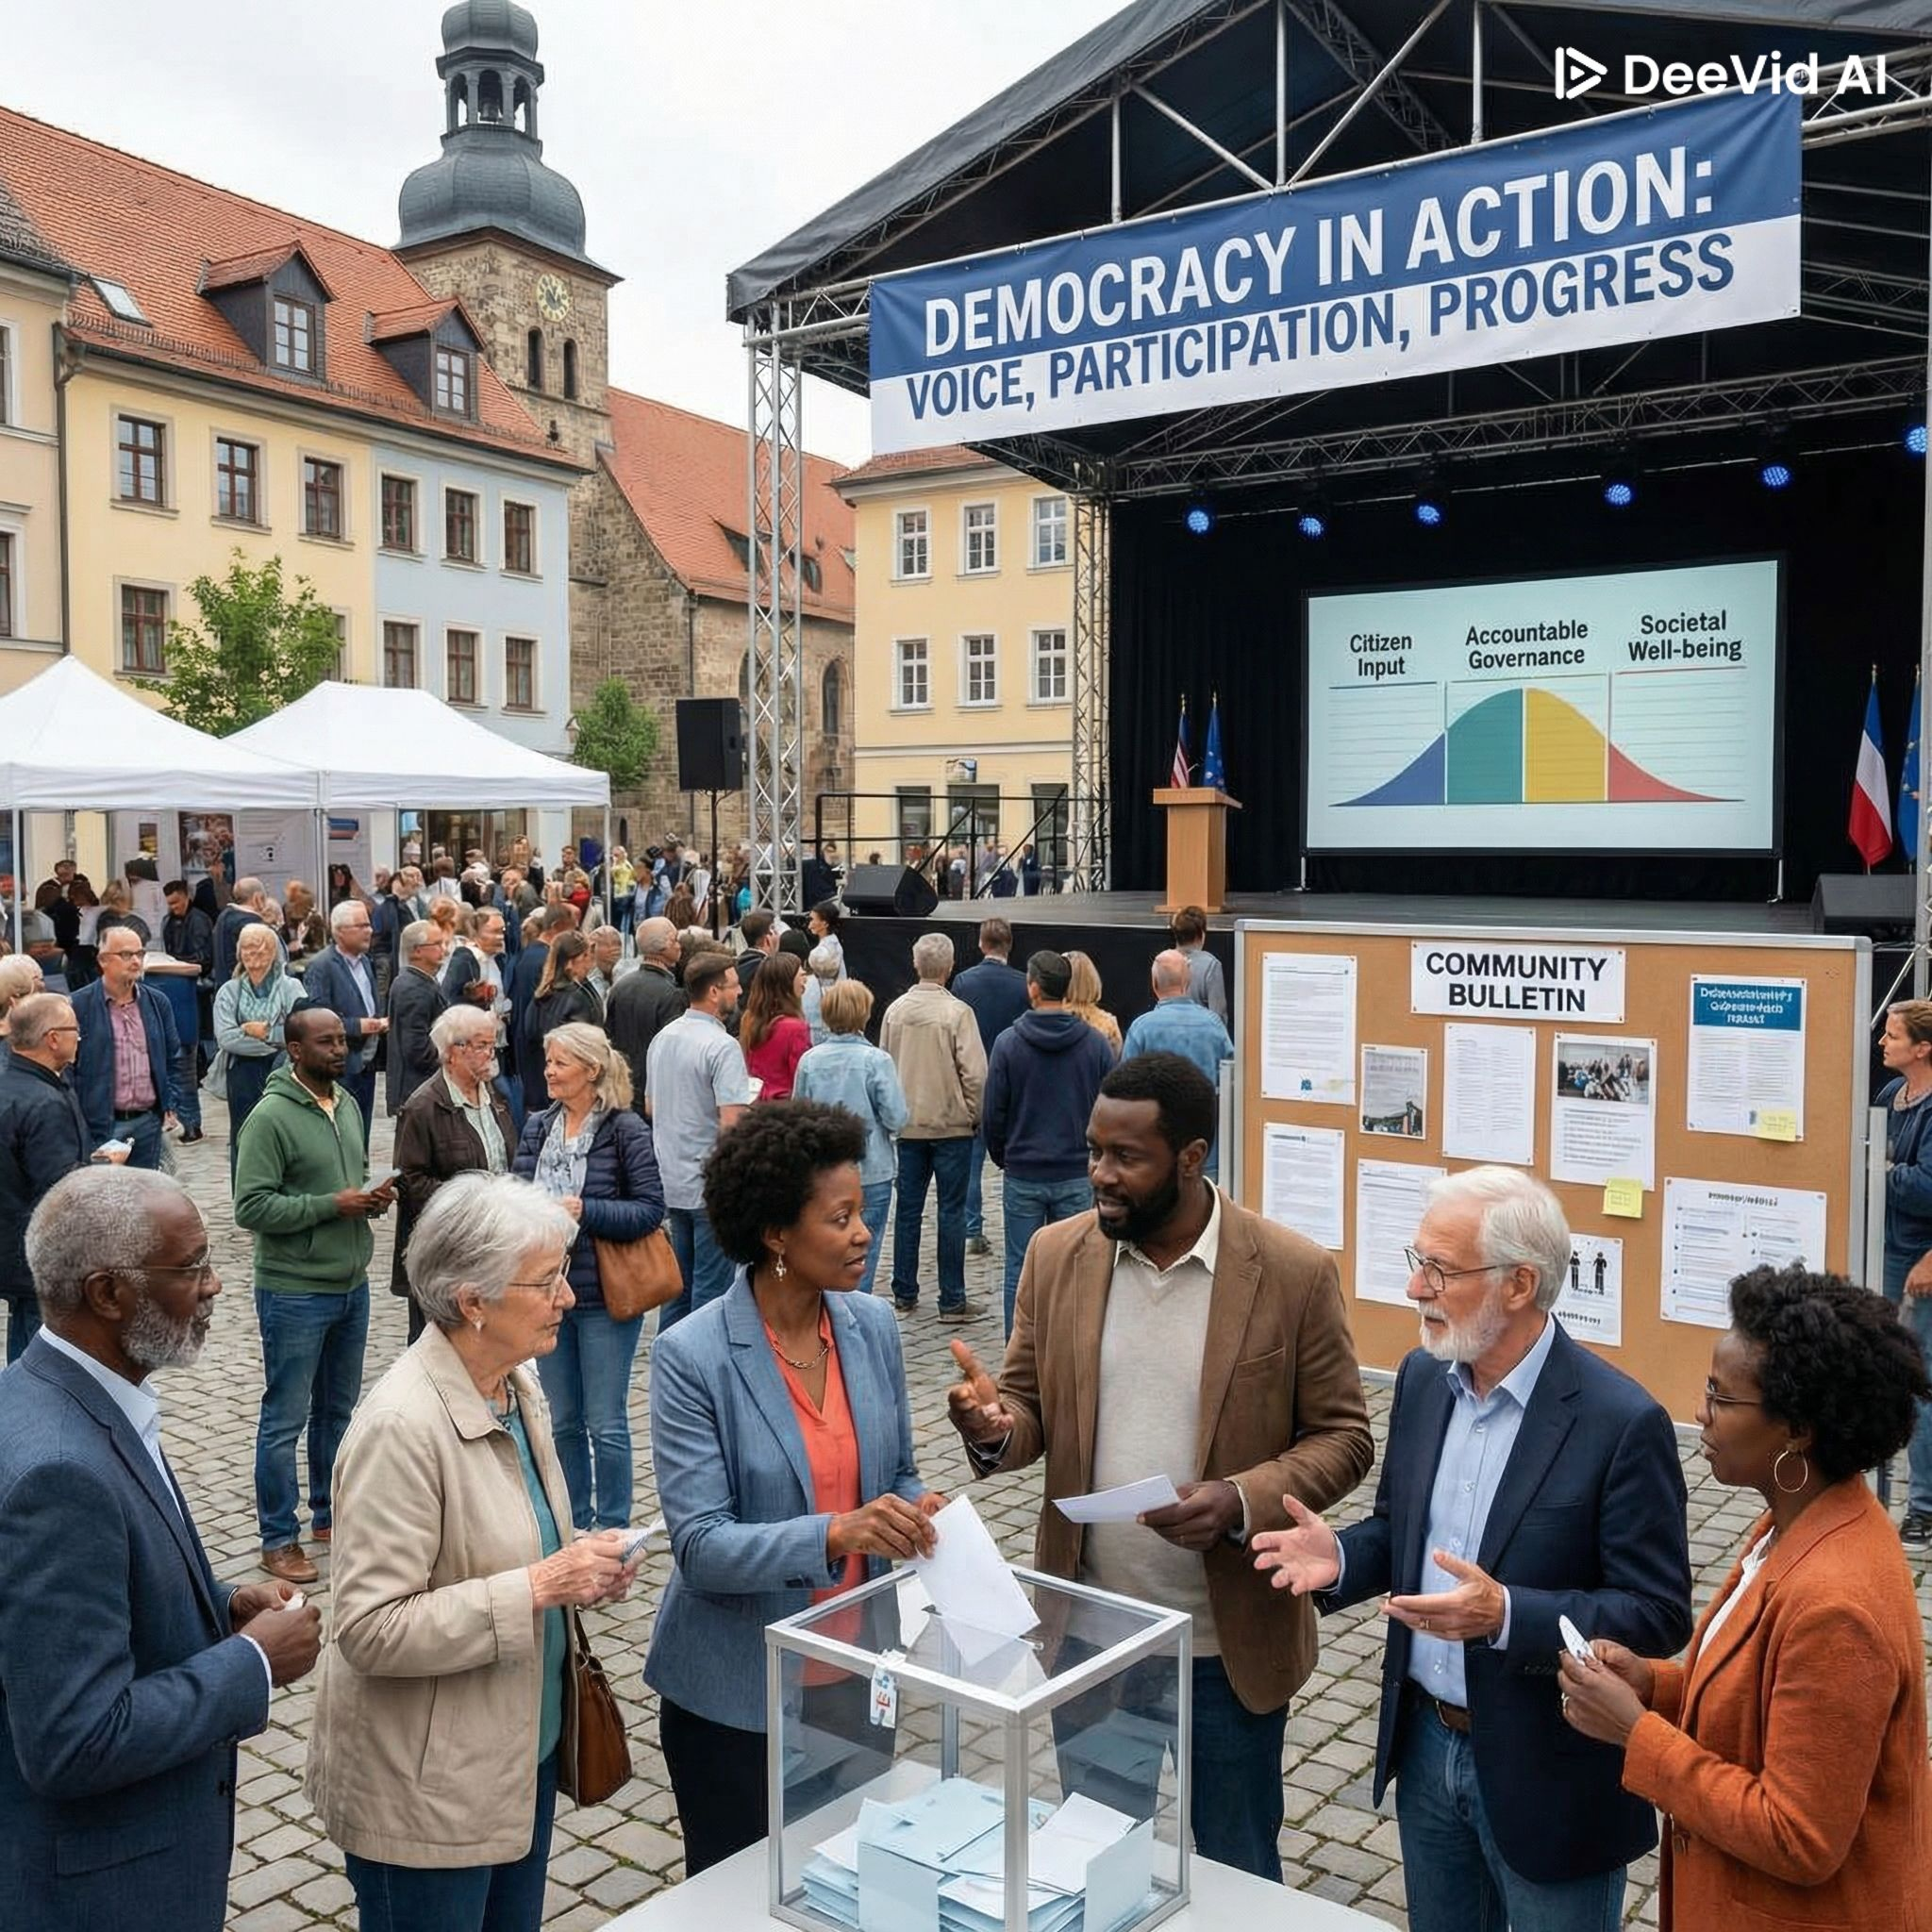
What is democracy?
At its core, democracy is a system of government where political power comes from the people. Citizens have the right to participate in decision-making, most commonly by voting in free and fair elections.
Core principles of democracy:
1.Free and fair elections
Leaders are chosen through regular elections where voters have real choices and results are respected.
2. Rule of law
Everyone — including leaders — is subject to the law. No one is above it.
3. Political equality
Each citizen’s vote carries (roughly) equal weight.

Slide 5
And what meritocracy is?
Meritocracy is a system where positions, rewards, and power are given based on merit — meaning ability, talent, effort, and achievement — rather than wealth, family background, class, or personal connections.
Core principles of meritocracy:
Equal opportunity
Everyone should have a fair chance to compete, regardless of background.
2. Performance-based advancement
People rise based on skills, results, and competence.
3. Objective evaluation
Clear criteria (exams, performance metrics, peer review) are used to judge merit.

Slide 6
Now let’s compare them:
Meritocracy
Democracy
Definition:
A system where power and advancement are based on individual ability, talent, and performance rather than wealth, status, or popularity.
Basis of Authority:
Skills, achievements, qualifications, and proven competence.
Decision-Making:
Decisions are made by the most capable or qualified individuals.
Leadership Selection:
Leaders rise through demonstrated talent, skill, or expertise.
Focus:
Excellence and efficiency: the best individuals lead, regardless of their popular appeal.
Definition:
A system of government where power rests with the people, usually exercised through voting and representation.
Basis of Authority:
Popular vote and majority consent.
Decision-Making:
Decisions are made collectively; majority opinion prevails.
Leadership Selection:
Leaders are elected by citizens regardless of background, experience, or ability.
Focus:
Equality in participation: everyone’s voice counts equally.

